Slide 1
Phoswich GATE Simulation Event Category Statistics
Bill Worstell
CapeSym
1/10/2022

Slide 2
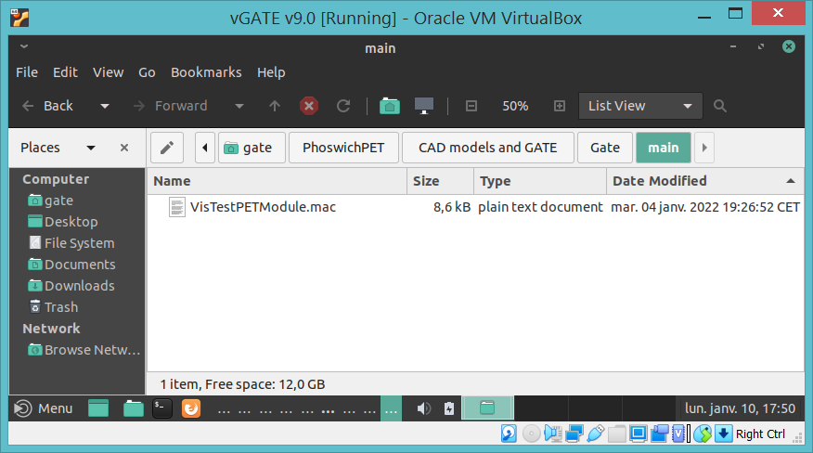
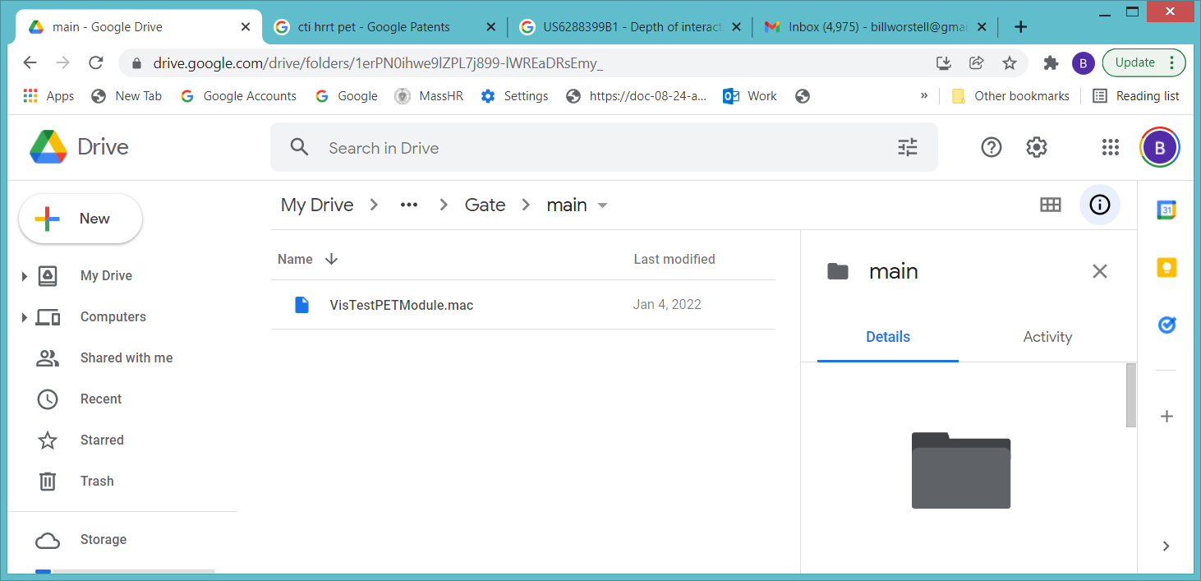
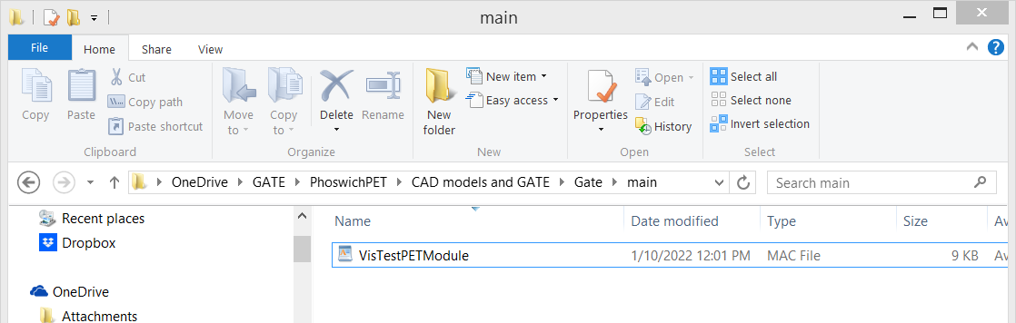
Virtual Machine
Communicates with Google Drive
Communicates with Google Drive
Communicates with Microsoft OneDrive
Host Machine

Slide 3
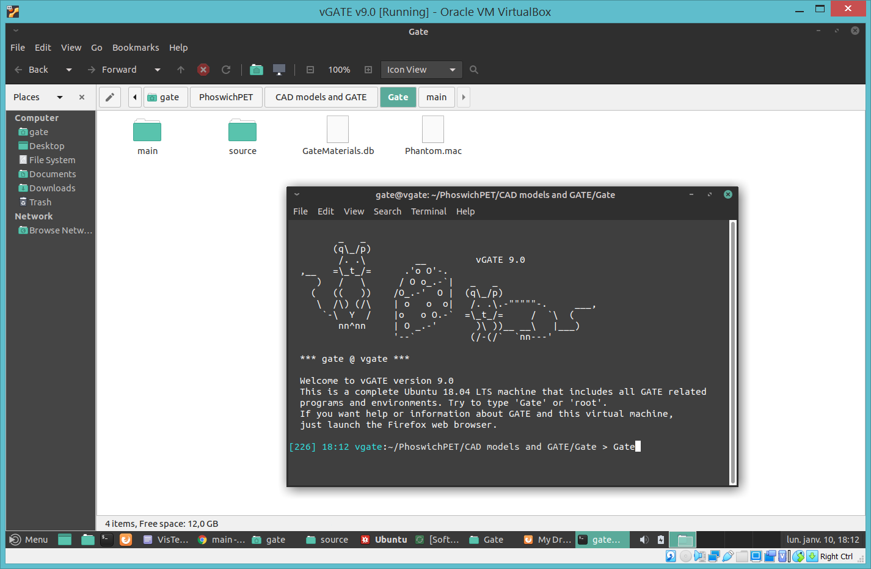
Launching
GATE on
Virtual
Machine

Slide 4
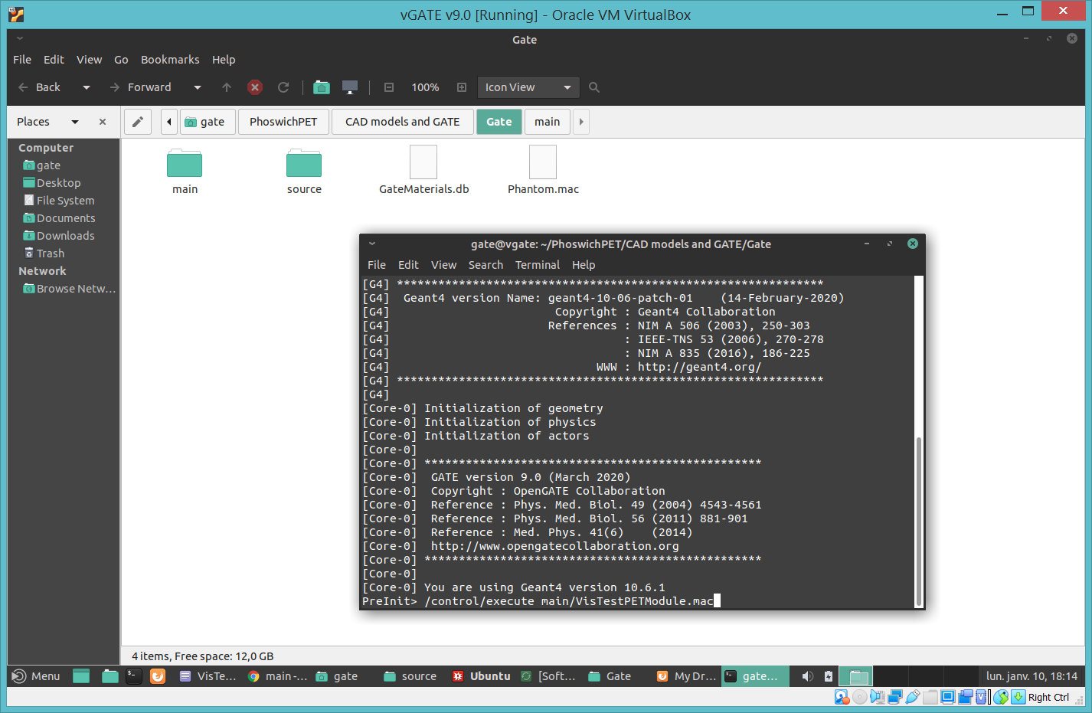
Executing
GATE
Macro

Slide 5
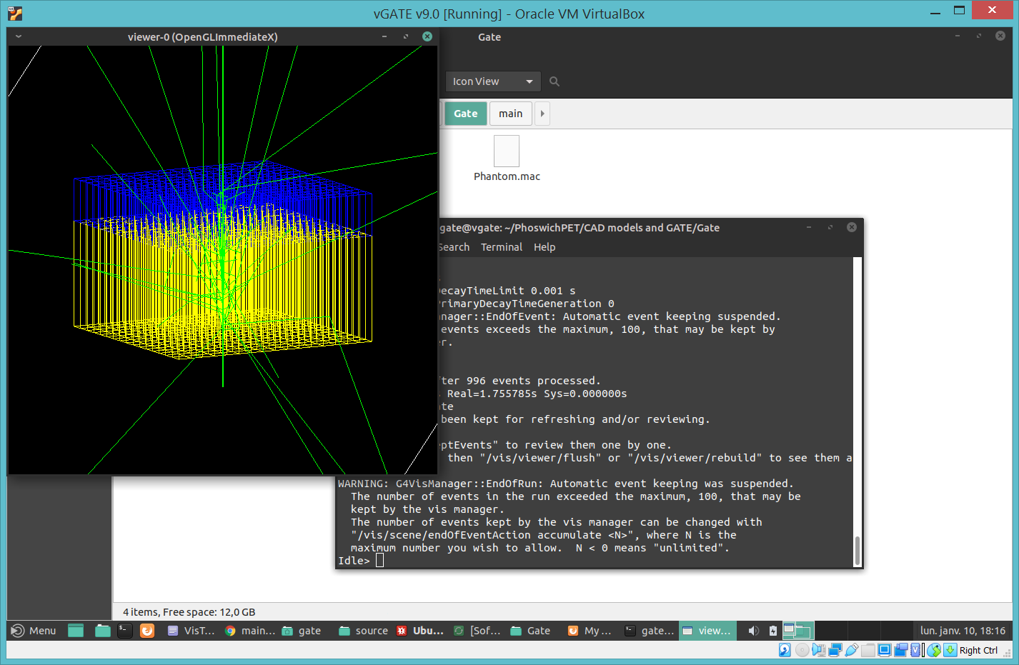
Displaying
GATE
Visualization

Slide 6
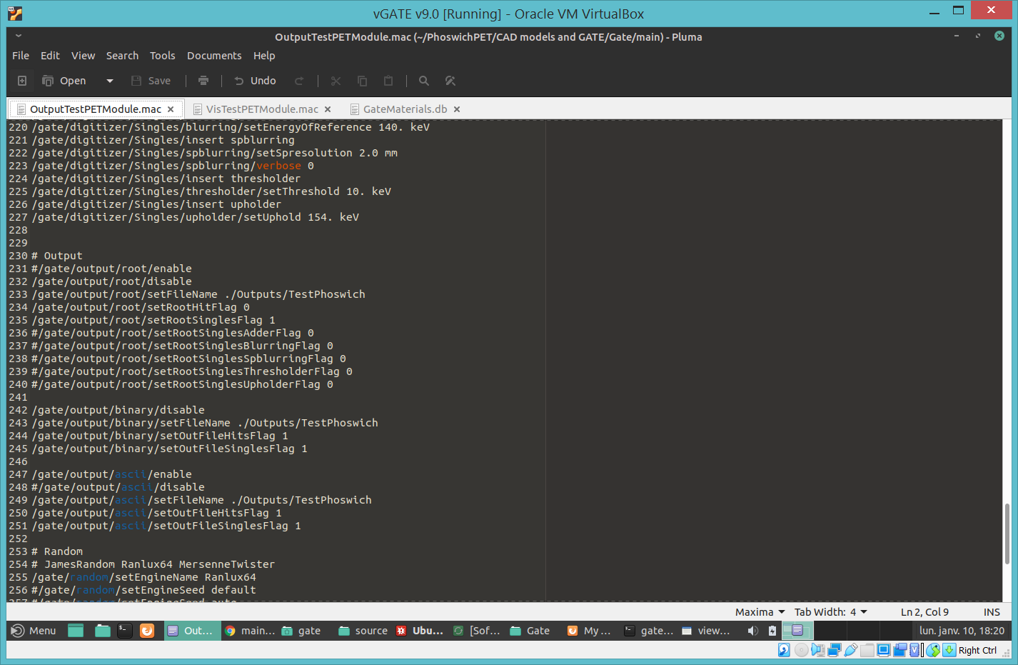
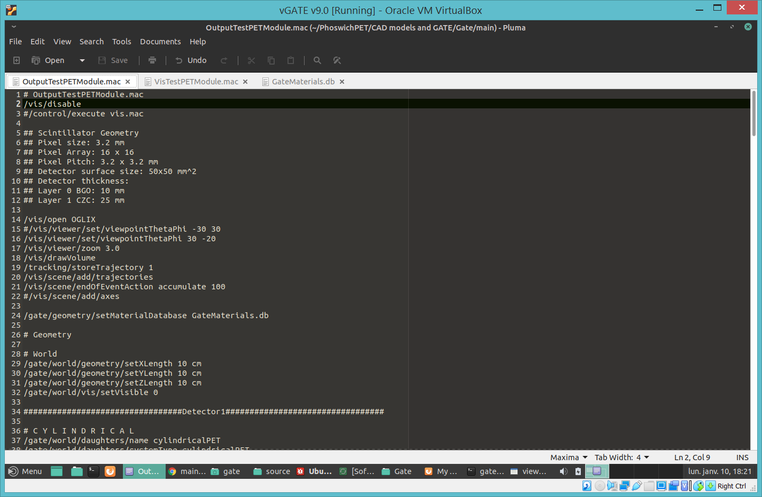
OutputTestPETModule.mac

Slide 7
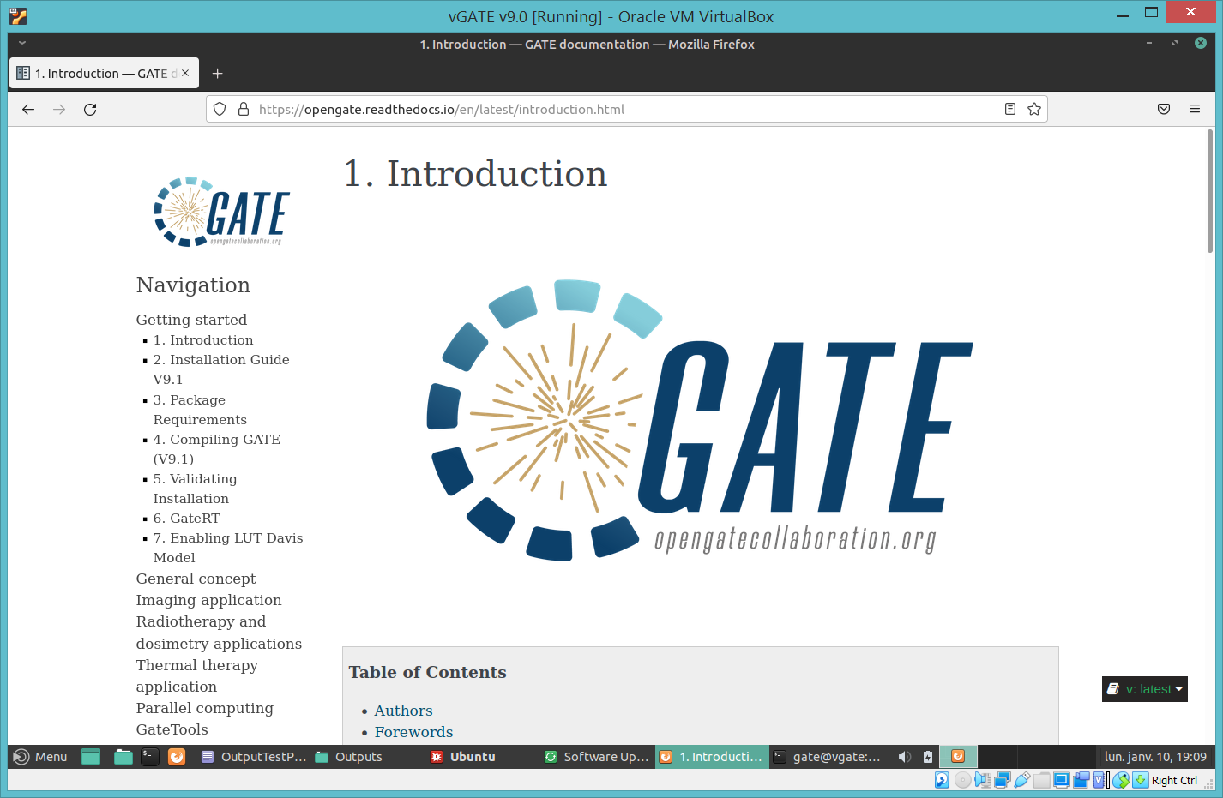
GATE Documentation

Slide 8
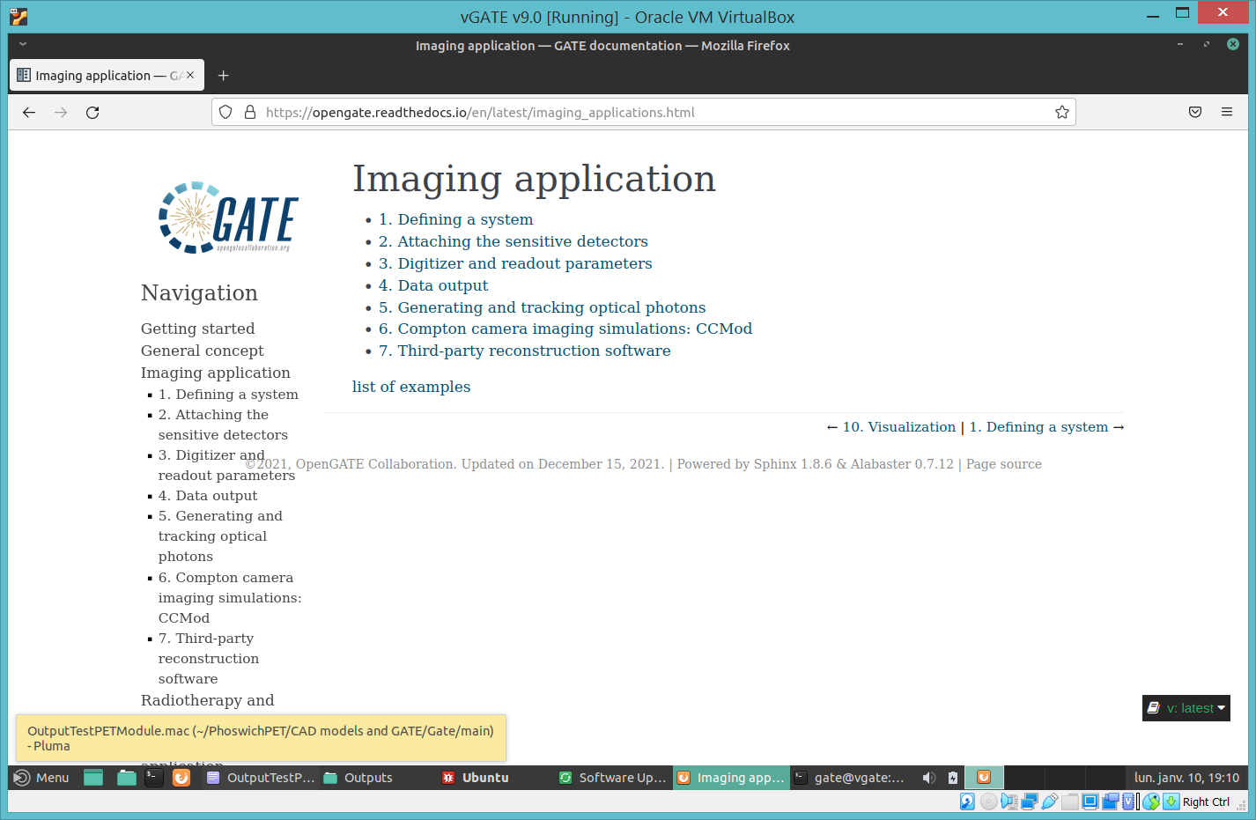
GATE Imaging application

Slide 9
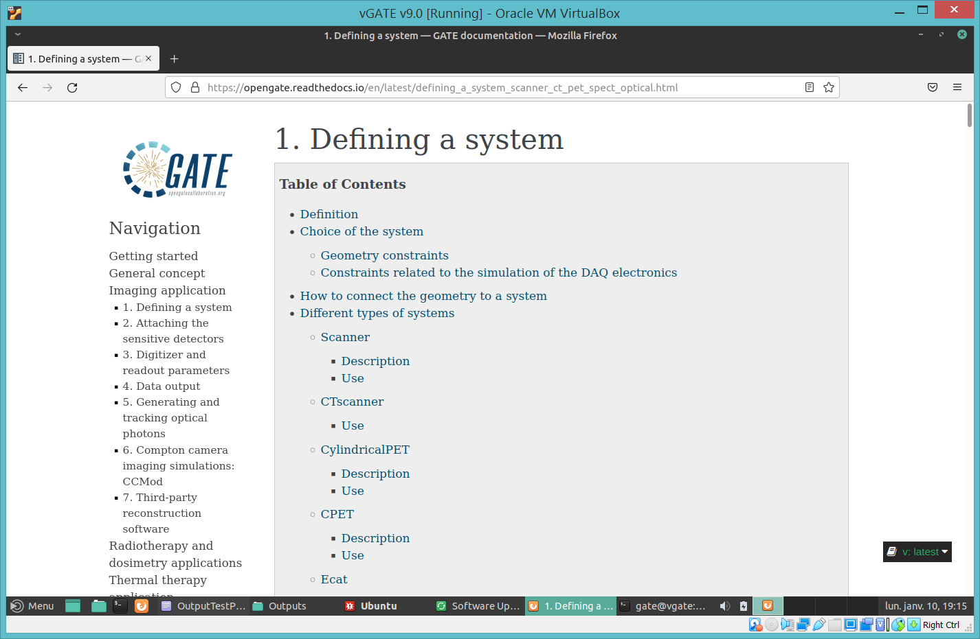
GATE system definition

Slide 10
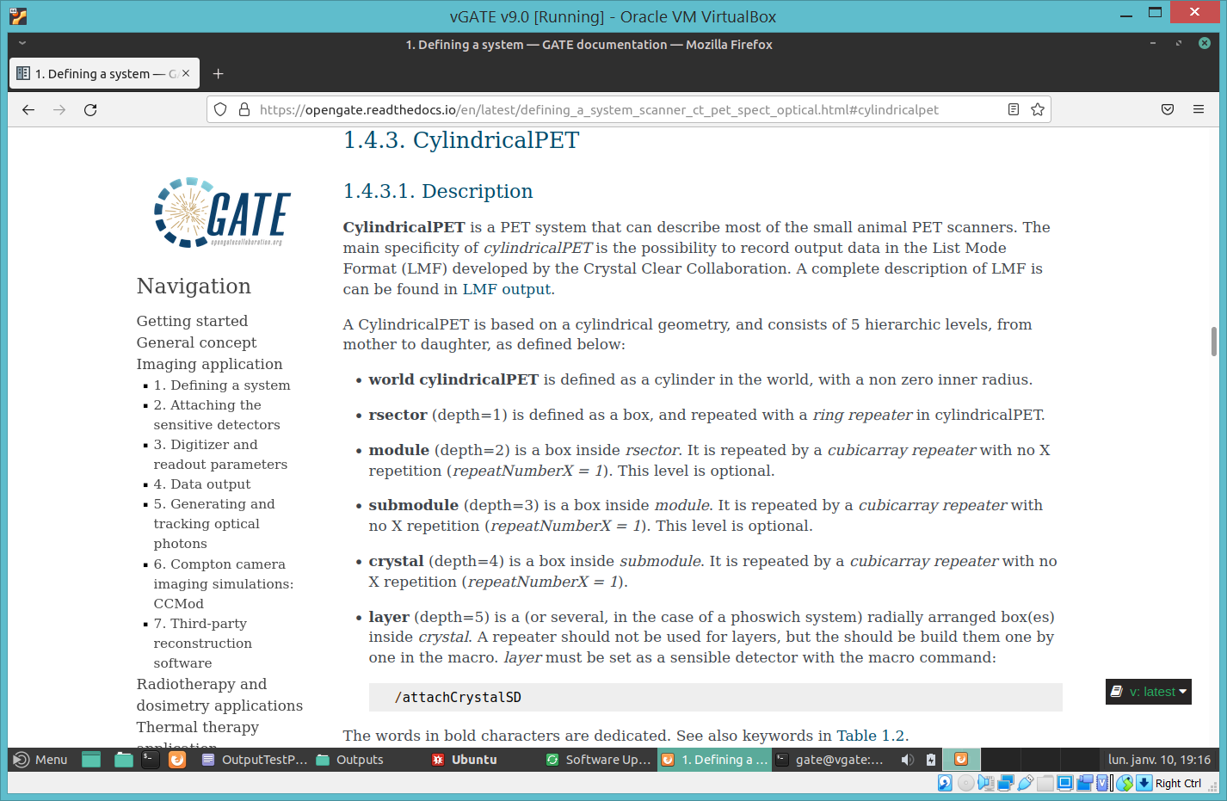
GATE CylindricalPET system

Slide 11
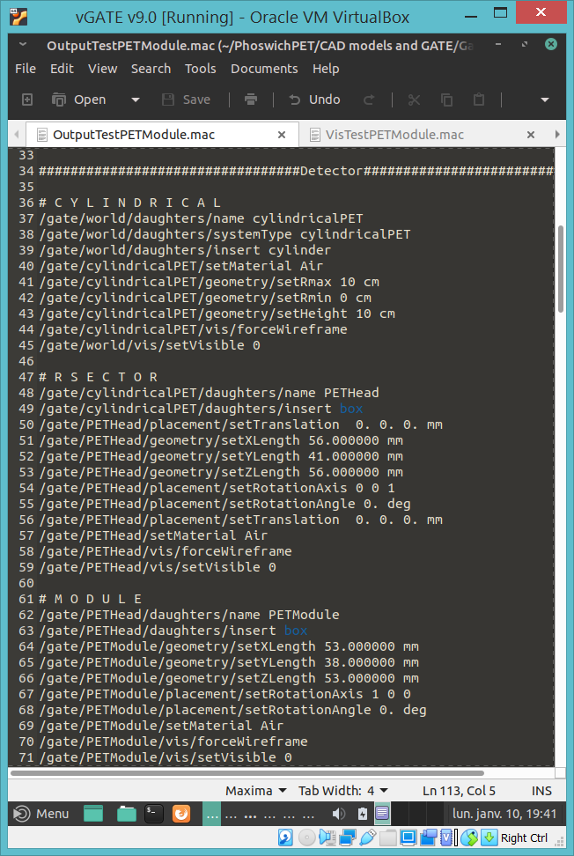
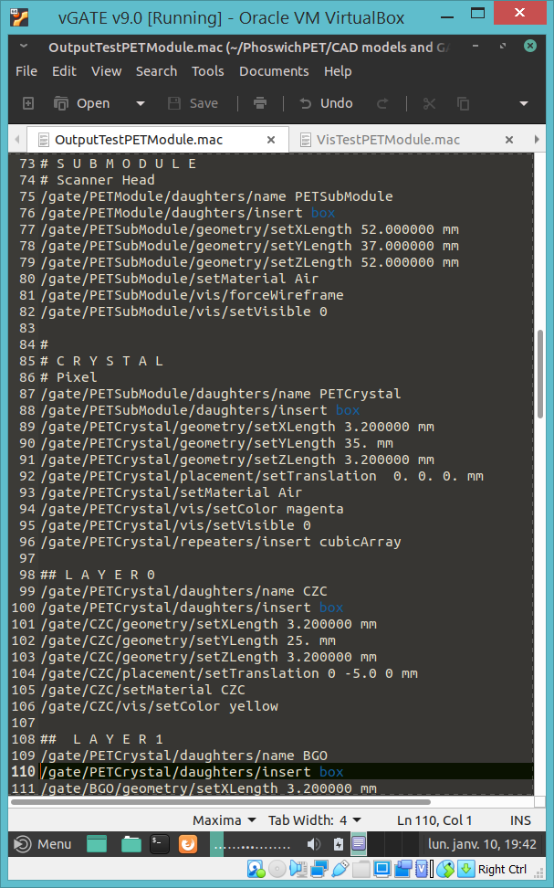
system (depth=0)-> cylindricalPET
rsector (depth=1) -> PETHead.
module (depth=2) -> PETModule
submodule (depth=3) ->
PETSubModule
crystal (depth=4) ->
PETCrystal
layer (depth=5) ->
CZC
BGO

Slide 12
cylindricalPET is defined as a cylinder in the world, with a non zero inner radius.
rsector (depth=1) is defined as a box, and repeated with a ring repeater in cylindricalPET.
module (depth=2) is a box inside rsector. It is repeated by a cubicarray repeater with no X repetition (repeatNumberX = 1). This level is optional.
submodule (depth=3) is a box inside module. It is repeated by a cubicarray repeater with no X repetition (repeatNumberX = 1). This level is optional.
crystal (depth=4) is a box inside submodule. It is repeated by a cubicarray repeater with no X repetition (repeatNumberX = 1).
layer (depth=5) is a (or several, in the case of a phoswich system) radially arranged box(es) inside crystal. A repeater should not be used for layers, but then should build them one by one in the macro. layer must be set as a sensible detector with the macro command:
/attachCrystalSD
system (depth=0)-> cylindricalPET
rsector (depth=1) -> PETHead.
module (depth=2) -> PETModule
submodule (depth=3) ->
PETSubModule
crystal (depth=4) ->
PETCrystal
layer (depth=5) ->
CZC
BGO

Slide 13
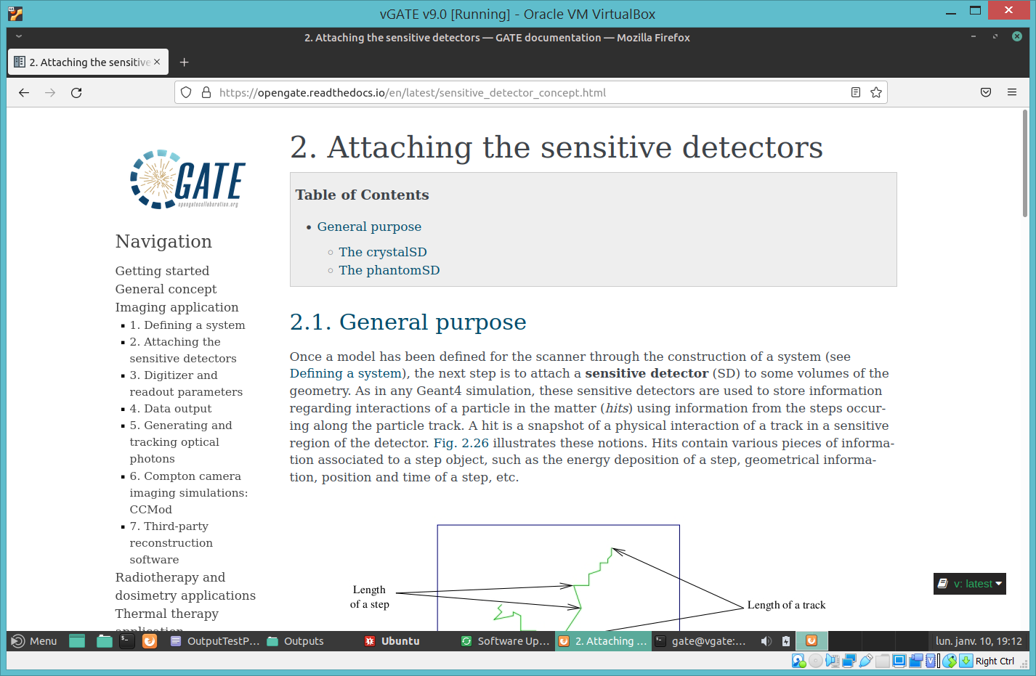
GATE sensitive detectors

Slide 14
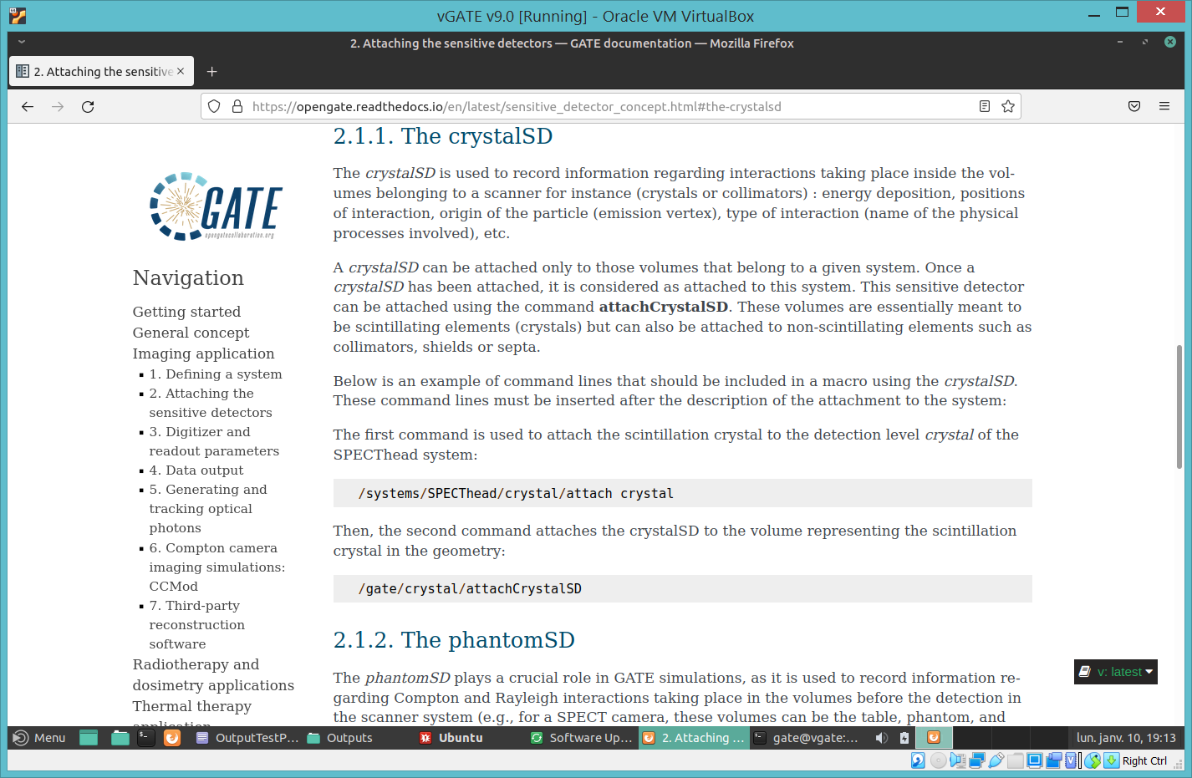
GATE crystalSD

Slide 15
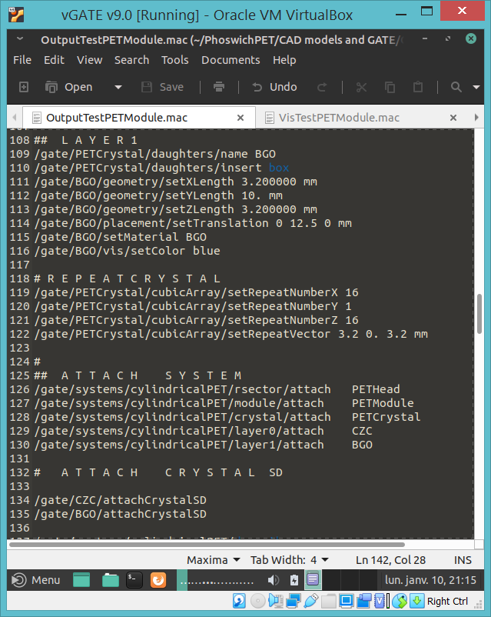
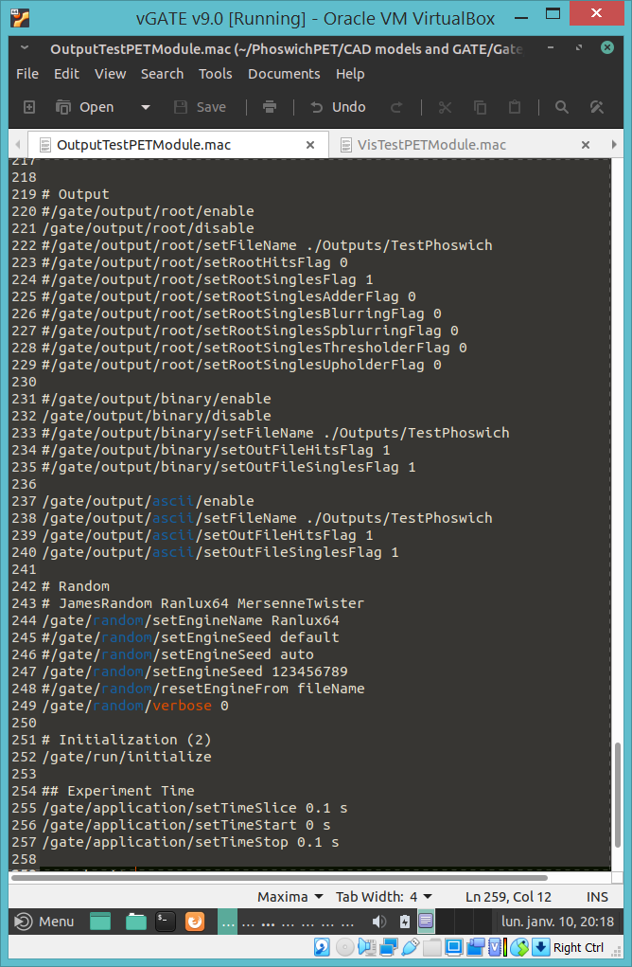
Attaching
Sensitive
Detectors
Selecting
Outputs
and Setting Run Length

Slide 16
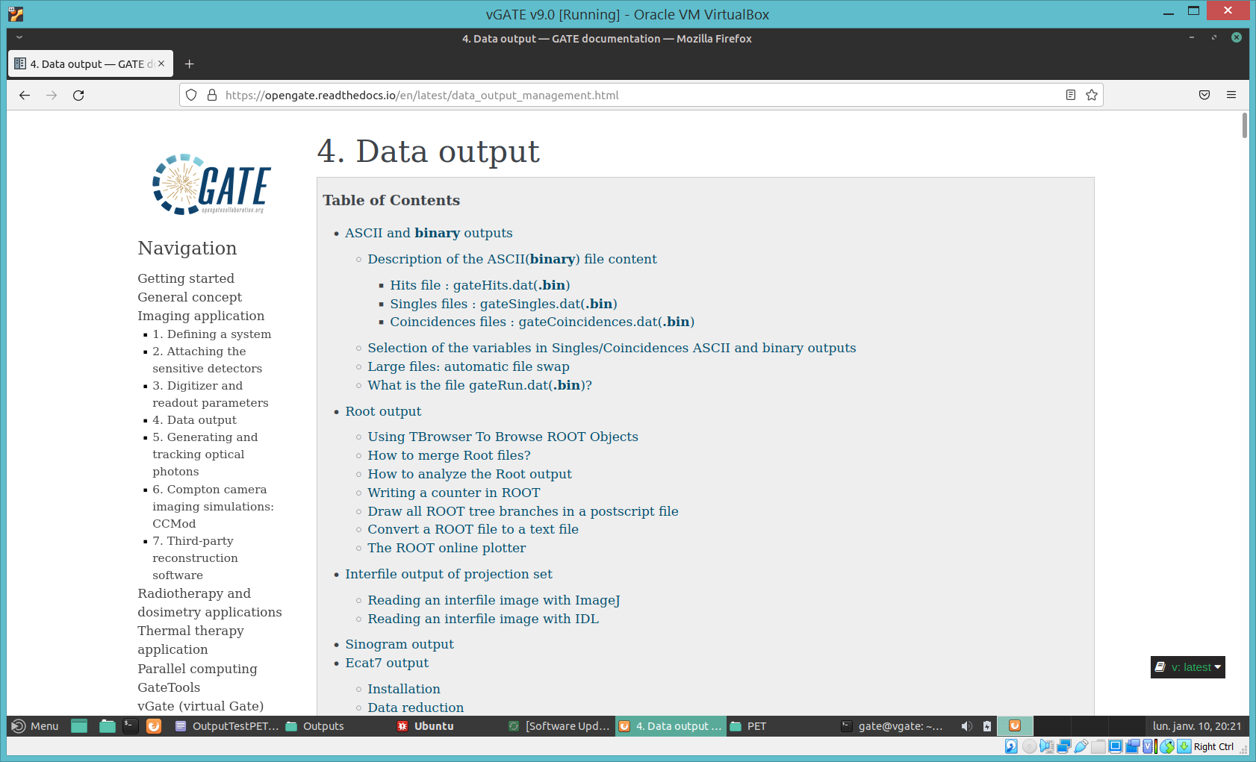
GATE Data output

Slide 17
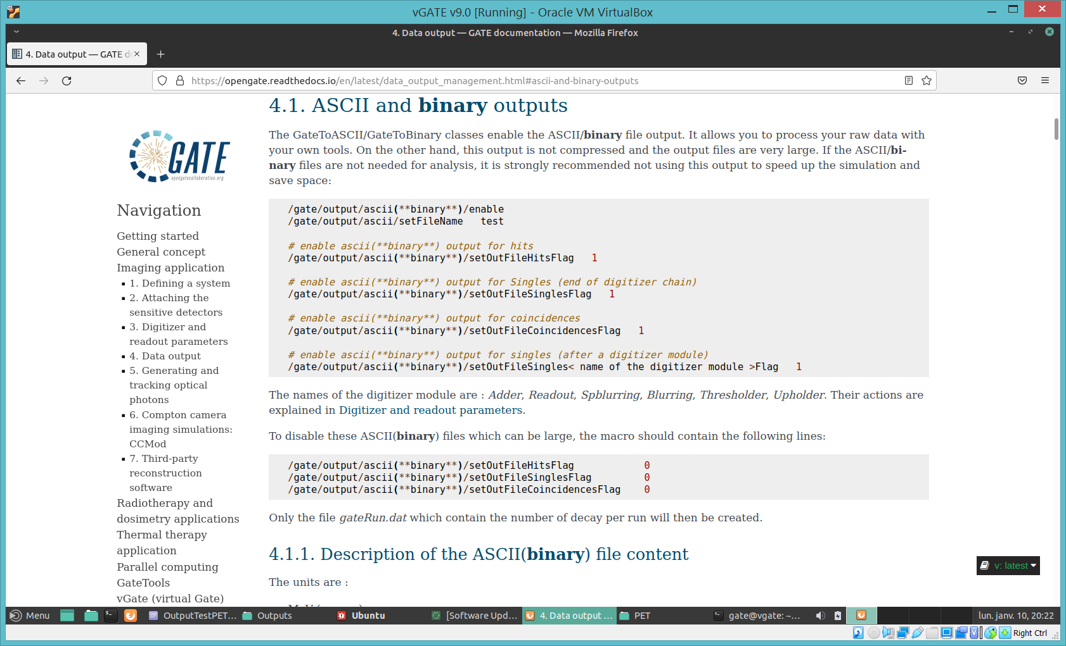
GATE ASCII and binary outputs

Slide 18
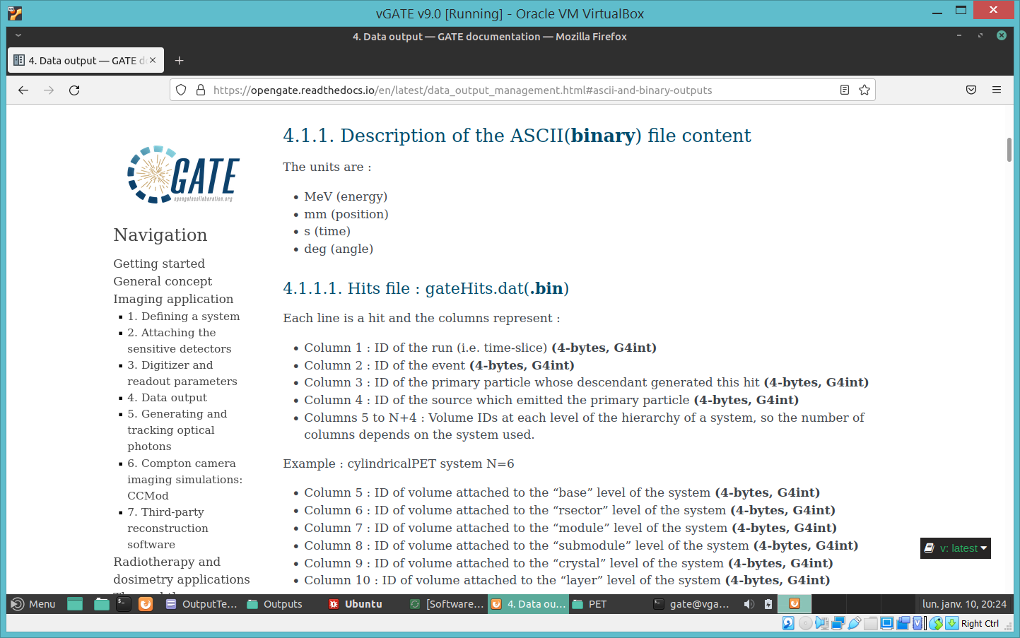
GATE ASCII/binary output format

Slide 19
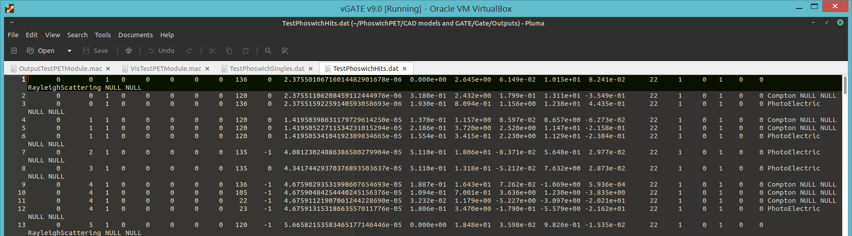
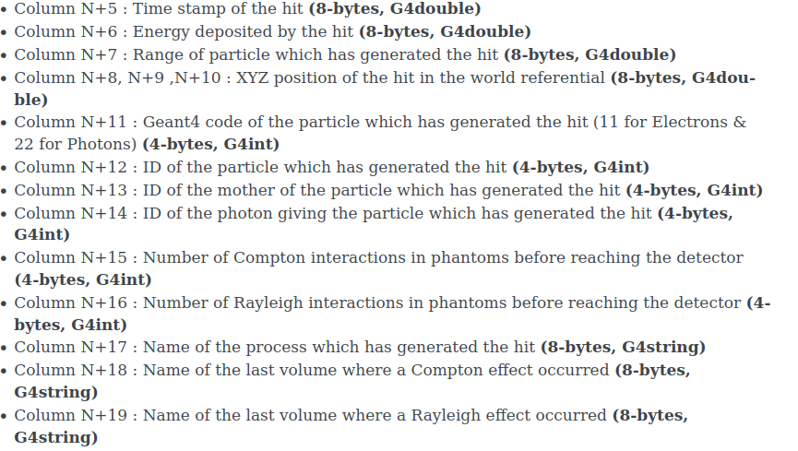
GATE Hits Output
Event
Layer
Energy
(MeV)
X
Y
Z
Interaction Type
Run
Time (s)
Range
(mm)
Crystal

Slide 20
GATE Hits Output
Event
Layer
Energy
(MeV)
X
Y
Z
Interaction Type
Run
Time (s)
Range
(mm)
Crystal

Slide 21
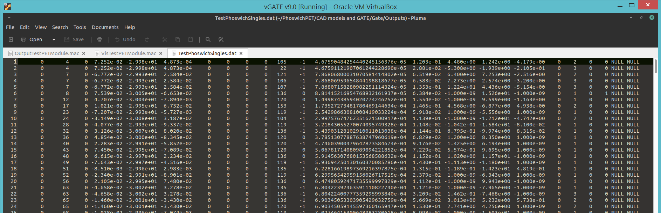
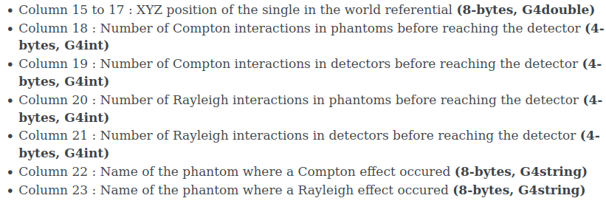
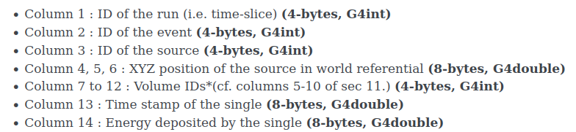
GATE Singles Output
Event
SX
SY
SZ
Time (s)
Interaction Type
Crystal
Energy
(MeV)
X
Y
Z
Run
Source
Layer

